Slide 1
Routing Principles
Lecture 4 (Routing 1)
CS 168, Spring 2025 @ UC Berkeley
Slides credit: Sylvia Ratnasamy, Rob Shakir, Peyrin Kao, Iuniana Oprescu
Notes:
Slides template credit: Josh Hug, Lisa Yan

Slide 2
Why Do We Need Routing?
Defining the Routing Problem
Why Do We Need Routing?
Modeling the Network
What Makes Routing Hard?
Types of Routing Protocols
Routing States
Destination-Based Forwarding
Routing State Validity
Least-Cost Routing
Static Routing
Lecture 4, CS 168, Spring 2025

Slide 3
Today's Goal: Routing
Today's goal is routing: Finding paths through the network.
We'll first formally define the problem.
Why is it needed?
Why is it a hard problem?
What types of algorithms exist?
Then, we'll see how to assess a solution.
What does a solution look like?
What makes a solution valid?
What makes a solution good?
R1
R4
D
A
R2
R3
R7
B
R5
R8
C
R6

Slide 4
Why Do We Need Routing? – Full Mesh Topology
If 2 machines want to communicate, we can add a link between them.
What if we had 5 machines?
We could add a link between every pair of machines.
The result is called a full-mesh topology.
Problem: This doesn't scale well. Imagine adding a new machine.
Has benefits in limited settings.
Good if we need dedicated high bandwidth between every pair of machines.
C
A
B
D
E

Slide 5
Why Do We Need Routing? – Single-Link Topology
Another approach: Use a single link (wire) to connect all 5 machines.
Scales better than the full-mesh topology.
Problem: Less bandwidth available. Everyone has to share the link.
A
B
C
D
E

Slide 6
Why Do We Need Routing? – Introducing Routers
To use more sophisticated topologies, we need to introduce a router.
Router: An intermediate machine that can forward data.
If we use routers to connect the machines:
We use fewer links than the full-mesh topology.
We have more capacity than just a single link.
A
B
R1
C
D
R2
R3
E

Slide 7
Why Do We Need Routing? – Introducing Routers
Another benefit: If a link goes down, traffic could use another path.
We now need some way to compute paths through the network: Routing protocols!
A
A
B
R1
C
B
R1
C
D
R2
R3
E
D
R2
R3
E
Link goes down!

Slide 8
Modeling the Network
Defining the Routing Problem
Why Do We Need Routing?
Modeling the Network
What Makes Routing Hard?
Types of Routing Protocols
Routing States
Destination-Based Forwarding
Routing State Validity
Least-Cost Routing
Static Routing
Lecture 4, CS 168, Spring 2025

Slide 9
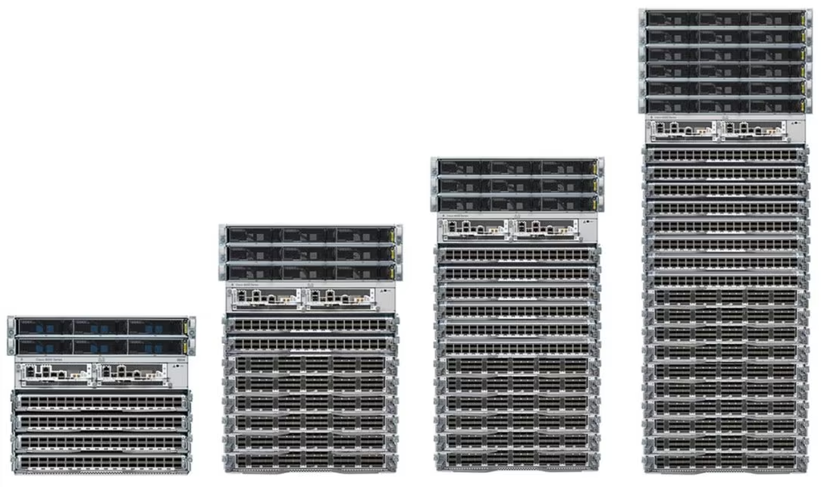
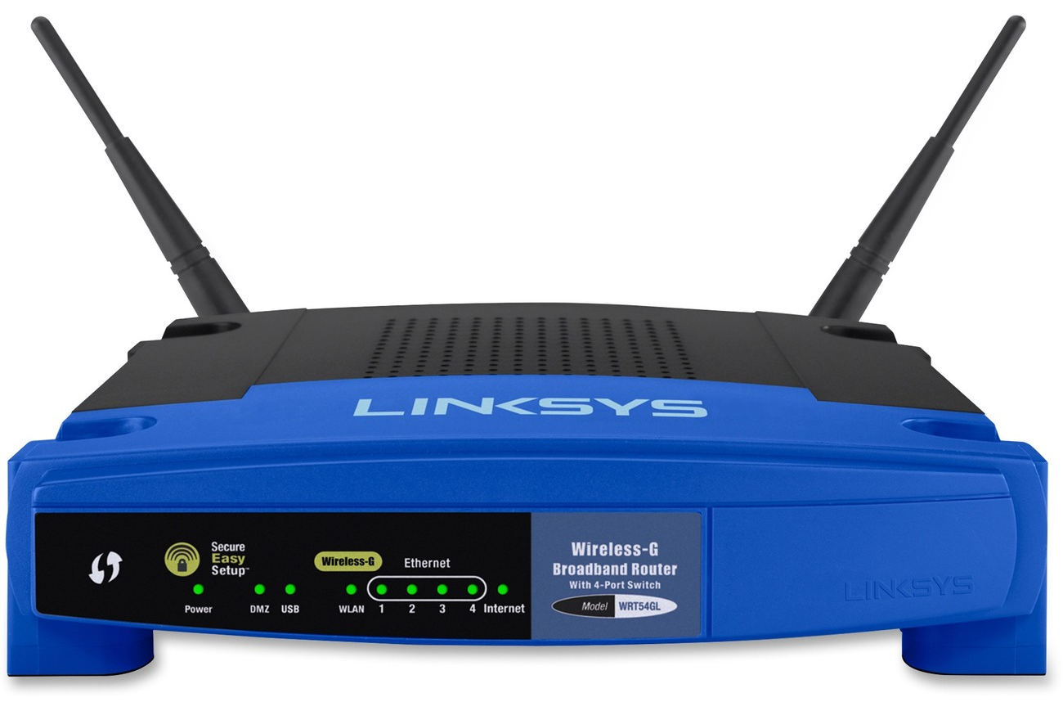
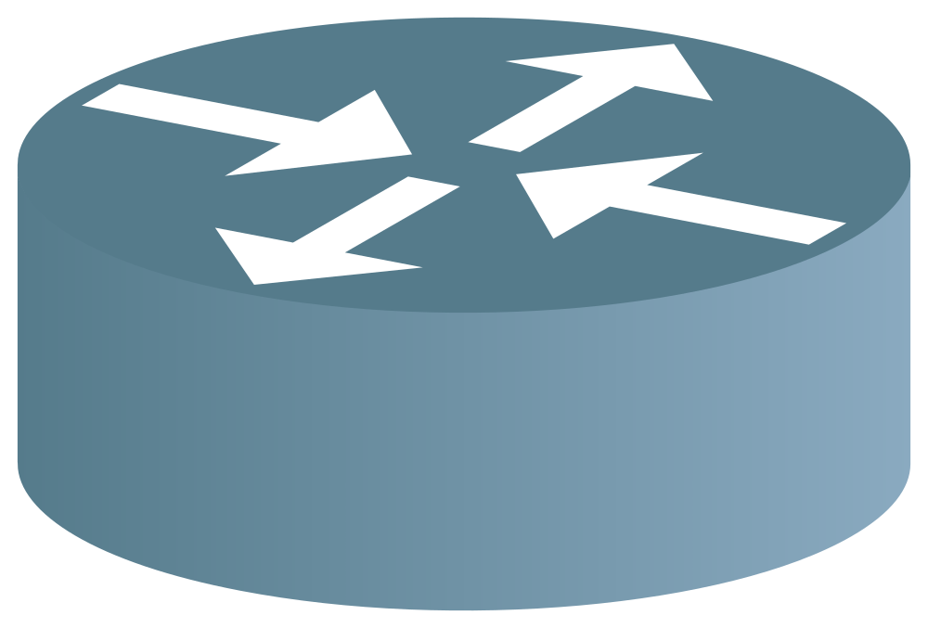
Modeling the Network – Routers vs. Hosts
We'll assume every machine on the network is one of two types.
End hosts send and receive packets, to and from other end hosts.
Example: Your personal computer.
End hosts don't forward intermediate packets.
Routers forward intermediate packets.
Example: Your home router, heavy-duty router in a datacenter.
For now, assume routers don't send and receive packets of their own.
Industrial-sized routers.
Home router.
Router symbol in diagrams.

Slide 10
Modeling the Network – Graph
We'll draw the network as a graph.
Each edge represents a link. For now, assume a link connects exactly 2 machines.
For now, assume each machine is identified by a unique label.
We'll think more about addressing later.
R1
R4
D
A
= End host
= Router
A
R2
R3
R1
R7
B
R5
R8
C
R6

Slide 11
Modeling the Network – Packets
Packets are the basic unit of data sent across the network.
Packets have a header with metadata.
For now, we only care about the source address and destination address fields.
Packets have a payload with the application data.
Example: Website contents, image, etc.
Routing isn't concerned about the payload. It's just some sequence of 1s and 0s we have to forward.
Source Address
Destination Address
Payload

Slide 12
What Makes Routing Hard?
Defining the Routing Problem
Why Do We Need Routing?
Modeling the Network
What Makes Routing Hard?
Types of Routing Protocols
Routing States
Destination-Based Forwarding
Routing State Validity
Least-Cost Routing
Static Routing
Lecture 4, CS 168, Spring 2025

Slide 13
What Makes Routing Hard? (1/3) – Changing Topologies
The network graph is constantly changing.
Hosts join and leave the network.
Links can fail, and new links can be added.
Our routing protocol needs to be robust to changes.
A
A
B
R1
C
B
R1
C
D
R2
R3
E
D
R2
R3
E
Link goes down!

Slide 14
What Makes Routing Hard? (2/3) – Distributed Protocols
Routers don't have a global, birds-eye view of the network.
If a link fails, routers don't automatically know about it.
Routing protocols have to be distributed.
There's no central mastermind computing the answer.
Each router computes its own part of the answer.
Routers must coordinate with each other in the protocol.
R1
R4
D
R2 can't see the whole network.
R2 might only be able to know about its direct neighbors.
A
R2
R3
R7
B
R5
R8
C
R6

Slide 15
What Makes Routing Hard? (3/3) – Best-Effort
At Layer 3, links are best-effort. Packets could get dropped.
In summary, challenges of routing:
Topology changes over time.
Routers don't have a global view of the network.
Links are best-effort.

Slide 16
Types of Routing Protocols
Defining the Routing Problem
Why Do We Need Routing?
Modeling the Network
What Makes Routing Hard?
Types of Routing Protocols
Routing States
Destination-Based Forwarding
Routing State Validity
Least-Cost Routing
Static Routing
Lecture 4, CS 168, Spring 2025

Slide 17
Routing Protocols – Disclaimer
There are an endless number of possible routing protocols.
We're going to talk about the "archetypal Internet."
We'll see some alternative approaches later.
Recall: The Internet is a network of networks.
The Internet does not have a single giant routing protocol.

Slide 18
Intra-Domain vs. Inter-Domain Routing
Intra-domain routing protocols compute routes within a single network.
Sometimes called Interior Gateway Protocols (IGPs).
Each network can choose their own intra-domain protocol based on their needs.
Networks differ in size (geographic, number of hosts), capacity (bandwidth, latency), support (money, staff), etc.

Slide 19
Intra-Domain vs. Inter-Domain Routing
Inter-domain routing protocols compute routes between networks..
Sometimes called Exterior Gateway Protocols (EGPs).
Everybody has to agree on the same protocol.
The Internet has used BGP since the 1990s.

Slide 20
Classifying Routing Protocols
Classifying routing protocols by where they operate:
Let individual networks choose how to route inside their network. (Intra-domain.)
Have all networks agree on how to route between each other. (Inter-domain.)
In practice, the lines between intra-domain and inter-domain routing are blurred.
Example: BGP is sometimes used inside networks, as well as between networks.
We can also classify routing protocols by how they operate:
Distance-vector protocols.
Path-vector protocols. (An extension to the distance-vector idea.)
Link-state protocols.

Slide 21
Destination-Based Forwarding
Defining the Routing Problem
Why Do We Need Routing?
Modeling the Network
What Makes Routing Hard?
Types of Routing Protocols
Routing States
Destination-Based Forwarding
Routing State Validity
Least-Cost Routing
Static Routing
Lecture 4, CS 168, Spring 2025

Slide 22
Routing Decisions
The basic challenge: When a packet arrives at a router, how does the router know where to send it next, such that it will eventually arrive at the desired destination?
The next hop is where to forward the packet next.
Which way do I forward this packet?
?
R2
From: A
?
To: B
Payload

Slide 23
Routing Decisions
Some bad strategies:
Send along a random link – bad because packet might not reach destination.
Send along every link – bad because wasting bandwidth.
Let's formalize what a solution looks like, and what makes it valid/good.
Which way do I forward this packet?
?
R2
From: A
?
To: B
Payload

Slide 24
Routing Decisions
The Internet uses destination-based forwarding.
Each router keeps a table, mapping destinations to next hops.
The decision only depends on the destination field of the packet.
B
R3
C
A
R1
R2
R4
D
R2's Table
Destination | Next Hop
A | R1
B | R3
C | R3
D | R4
From: A
When a packet arrives, look up the destination...
...and send along the corresponding next hop.
To: B
Payload

Slide 25
Routing Decisions
In real life, the table often uses physical ports instead of next hops.
Conceptual: "Send to next-hop of R3."
Reality: "Send out of physical port 1."
We'll use the conceptual picture for simplicity.
B
R3
0
1
C
A
R1
R2
2
R4
D
R2's Table (Conceptual)
Destination | Next Hop
A | R1
B | R3
C | R3
D | R4
R2's Table (Reality)
Destination | Port
A | 0
B | 1
C | 1
D | 2

Slide 26
Routing vs. Forwarding
Forwarding:
Look up packet's destination in table, and send packet to neighbor.
Inherently local. Depends only on arriving packet and local table.
Occurs every time a packet arrives (nanoseconds).
Routing:
Communicates with other routers to determine how to populate tables.
Inherently global. Must know about all destinations, not just local ones.
Occurs every time the network changes (e.g. a link fails).
Not local!
R2's Table
Destination | Port
A | 0
B | 1
C | 1
D | 2
B
To: B
R3
1
1
C
R2
A
R1
0
R2
0
2
2
R4
D
Forwarding is local.
Routing is global.

Slide 27
Routing State Validity
Defining the Routing Problem
Why Do We Need Routing?
Modeling the Network
What Makes Routing Hard?
Types of Routing Protocols
Routing States
Destination-Based Forwarding
Routing State Validity
Least-Cost Routing
Static Routing
Lecture 4, CS 168, Spring 2025

Slide 28
Routing State Validity is Global
A routing state is valid if packets actually reach their destinations.
A local routing state is a table in a single router.
By itself, the state in a single router can't be evaluated for validity.
B
R3
A
R1
R2
C
R4
D
?
?
?
R2's Table
Destination | Next Hop
A | R1
B | R3
C | R3
D | R4
Is this local state valid?
Will it get my packets to their destinations?
No way to tell from just this info!
The term "routing state validity" might only be used at Berkeley.

Slide 29
Routing State Validity is Global
A global routing state is a collection of tables in all routers.
Global state determines the paths a packet takes.
Global state is valid if it produces forwarding decisions that deliver packets to their destinations.
Given a global state, how can you tell if it's valid?
B
R3
A
R1
R2
C
R4
D
R1's Table
Destination | Next Hop
A | A
B | R2
C | R2
D | R2
R2's Table
Destination | Next Hop
A | R1
B | R3
C | R3
D | R4
R3's Table
Destination | Next Hop
A | R2
B | B
C | C
D | R4
R4's Table
Destination | Next Hop
A | R2
B | R2
C | R2
D | D

Slide 30
Routing State Validity Conditions
A global routing state is valid if and only if there are no dead ends and no loops.
Dead end: A packet arrives at a router, but there is no next hop to forward it.
Packet arriving at destination doesn't count as a dead end.
Loop: A packet cycles around the same set of routers.
If forwarding only depends on destination field, if a packet gets stuck in a loop, it can never escape.
A
R1
R2
R3
R4
B
Uh oh. R3 didn't forward the packet.
A
R1
R2
R3
R4
B
Uh oh. Packet is stuck looping between R2 and R3.

Slide 31
Routing State Validity Proof
A global routing state is valid (i.e. packets reach their destination) if and only if there are no dead ends and no loops.
To prove this, we to check both directions (necessary and sufficient).
Packets reach their destination only if there are no dead ends and loops. (Necessary.)
Proof:
If you hit a dead end, you'll never reach the destination.
If you get stuck in a loop, you'll never reach the destination.
In destination-based forwarding, no way to escape the loop. Forwarding decision is the same every time the packet arrives at a router.
Destination isn't part of the loop. It wouldn't have forwarded the packet!

Slide 32
Routing State Validity Proof
If there are no dead ends and loops, packets will reach their destination. (Sufficient.)
Proof:
Assume there are no loops and dead ends. Then:
Packet won't visit the same router twice. (We said no loops.)
Packet won't stop before hitting destination. (We said no dead ends.)
Therefore:
Packet must keep wandering the network, visiting different routers.
There are only a finite number of unique routers to visit.
So the packet must eventually hit the destination.
We've proven both directions!

Slide 33
Verifying Routing State Validity
A global routing state is valid if and only if there are no dead ends and no loops.
How do we apply this condition to check if a global state is valid?
Strategy: Check each destination separately.
For a given destination: Use the tables to see how each router forwards packets.
The next-hop becomes an outgoing arrow.
The result is a directed delivery tree for that destination.
R1
R2's Table
Destination | Next Hop
A | R3
... | ...
R4
R2
R3
R6
A
R5

Slide 34
Verifying Routing State Validity
A directed delivery tree shows how packets get forwarded toward one destination.
Properties:
At each router, 1 next-hop per destination. 1 outgoing arrow per node!
Once paths meet, they never split. (Same destination = same next hop.)
For now, ok to assume this.
Allowed:
Not allowed:
R1
Paths meet at R4 and never split again.
R4
R2
R3
R6
A
R5

Slide 35
Verifying Routing State Validity
A valid directed delivery tree is an oriented spanning tree rooted at the destination.
Oriented = Edges have arrows.
Spanning = Tree touches every node.
Tree = No cycles, no disconnected components.
All edges point toward destination.
Starting at any node and following edges will reach the destination.
R1
R4
R2
R3
R6
A
R5

Slide 36
Verifying Routing State Validity – Steps
Pick a single destination.
For each router, draw an arrow to the next-hop.
Destination-based forwarding = there is only one outgoing arrow.
Delete all links with no arrows.
State is valid if and only if the remaining graph is a valid directed delivery tree.
No dead ends. (Node with no outgoing arrow.)
No loops. (Cycles in the graph.)
A directed spanning tree where all edges point toward the destination.
Repeat for every destination!
Touches every node.
No cycles. No disconnected nodes.

Slide 37
Verifying Routing State Validity – Steps
Is this global routing state valid?
Recall: Global routing state = what's in all the forwarding tables.
E
F
B
A
D
C

Slide 38
Verifying Routing State Validity – Steps
1. Pick a single destination. We'll pick A.
E
F
B
A
D
C

Slide 39
Verifying Routing State Validity – Steps
2. For each router, draw an arrow to the next-hop.
E
F
B
A
D
C

Slide 40
Verifying Routing State Validity – Steps
3. Delete all links with no arrows.
4. State is valid for A! Spanning tree where all edges point toward the destination.
5. Repeat for the other destinations.
E
F
B
A
D
C

Slide 41
Verifying Routing State Validity – Invalid State Example
Is this valid?
No – Not a spanning tree, because there's a loop.
E
F
B
Loop!
A
D
C

Slide 42
Verifying Routing State Validity – Invalid State Example
Is this valid?
No – Not a spanning tree, because there's a disconnected component (dead end).
E
F
B
Dead end!
A
D
C

Slide 43
Least-Cost Routing
Defining the Routing Problem
Why Do We Need Routing?
Modeling the Network
What Makes Routing Hard?
Types of Routing Protocols
Routing States
Destination-Based Forwarding
Routing State Validity
Least-Cost Routing
Static Routing
Lecture 4, CS 168, Spring 2025

Slide 44
Least-Cost Routing
We now know what a valid solution looks like (no loops, no dead ends).
What makes a solution good?
Many different ways to define good, including:
Price.
Propagation delay.
Distance.
Unreliability.
Bandwidth constraints.

Slide 45
Least-Cost Routing – Definition
Least-cost routing: Assign costs to every edge, and find paths with lowest cost.
Cost depends on the metric the operator wants to minimize.
Costs can be arbitrary. Routing protocols don't care where the costs come from.
R1
2
2
R4
1
D
A
1
R2
2
1
R3
1
10
R7
B
1
R5
2
R8
1
C
1
R6
2

Slide 46
Least-Cost Routing – Definition
In least-cost routing, routers should forward packets such that they take the lowest-cost path to the destination.
Example: If all costs are 1, the protocol finds paths with the fewest hops.
Usually, if edges are unlabeled, assume they have cost 1.
1
R1
1
R1
R2
10
R2
10
1
1
A
1
R3
2
R4
1
B
A
1
R3
2
R4
1
B
7
1
7
1
R5
R5
A → B Cost = 7
A → B Cost = 14

Slide 47
Least-Cost Routing – Properties
Where do costs come from?
Costs are local to a router. Each router knows the cost of its own links.
In practice, generally configured by an operator.
Some protocols allow for auto-configuration.
Properties of costs:
Costs are always positive integers.
Can't traverse an edge and make a path cheaper.
Consistent with almost any practical metric you'd use.
Costs are always symmetrical.
A → B costs the same as B → A.
Exceptions possible in theory (e.g. different upload/download bandwidth).
These two assumptions will simplify our protocols.

Slide 48
Least-Cost Routing — Good Paths
Good paths (least-cost) also valid paths (no loops, no dead ends).
Costs are positive, so there are no loops. They'd only increase the cost.
Routes are still destination-based.
Routes still form a spanning tree.

Slide 49
Static Routing
Defining the Routing Problem
Why Do We Need Routing?
Modeling the Network
What Makes Routing Hard?
Types of Routing Protocols
Routing States
Destination-Based Forwarding
Routing State Validity
Least-Cost Routing
Static Routing
Lecture 4, CS 168, Spring 2025

Slide 50
Special Route Types
Recall: In a routing protocol, routers talk to each other to populate forwarding tables and learn paths to destinations.
Some table entries can be manually hard-coded.
Connected/Direct routes let us forward to things we're connected to directly.
These routes are created when the operator configures the router.
No routing protocol needed for these entries.
R1's Table
Destination | Next Hop
A | Direct
B | R2
C | R2
D | R2
B
R3
C
A
R1
R2
R4
D

Slide 51
Special Route Types
Some table entries can be manually hard-coded.
Static routes are hard-coded entries that we always want to be there.
Router isn't necessarily directly connected to the destination.
The route is static because:
It never changes.
No routing protocol used to discover it.
Again, often manually created by an operator.

